Slide 1
Aspect-Based Sentiment Analysis (ABSA)
Comparative Implementation & Evaluation
Vladalin Bosii and Aleksiya Solovyova, class 302

Slide 2
Problem Statement
Aspect-Based Sentiment Analysis (ABSA) identifies specific aspects in text (e.g., food, service, ambiance) and determines sentiment for each aspect independently.
Project Goal
Implement and compare multiple ABSA approaches with a shared interface for fair evaluation.
Key Outputs: Aspect, Sentiment, Confidence (optionally with text spans)

Slide 3
Three Implementations
1. LexiconABSA
Rule-based NLP approach using linguistic patterns
2. TransformerABSA
Pre-trained transformer model
3. LLMABSA
Large Language Model prompting

Slide 4
LexiconABSA: Rule-Based Approach
Core Technology: spaCy + NLTK VADER
Key Features
Fast & simple
CPU-only, minimal resources
No training needed
Stable outputs
Trade-off: Struggles with implicit aspects and sarcasm

Slide 5
TransformerABSA: Pretrained Transformer Model
Core Technology: DeBERTa-v3 (yangheng/deberta-v3-base-absa-v1.1)
Key Features
Strong contextual understanding
GPU-accelerated
High classification accuracy
Probabilistic confidence scores
Trade-off: Higher resource usage, simplistic aspect extraction

Slide 6
LLMABSA: Large Language Model Approach
Core Technology: Qwen 2.5 7B via Ollama
Key Features
Most flexible extraction
Best zero-shot performance
Highest overall accuracy
Easy adaptation via prompting
Trade-off: Slow processing, high computational cost

Slide 7
Experimental Setup
Dataset
100 Yelp-inspired restaurant reviews
Evaluation Metrics
Classification: Accuracy, Precision, Recall, F1 Score
Behavior: Average aspects per review, confidence levels
Performance: Processing time per review
Testing
Jupyter notebook for automated comparison across all models

Slide 8
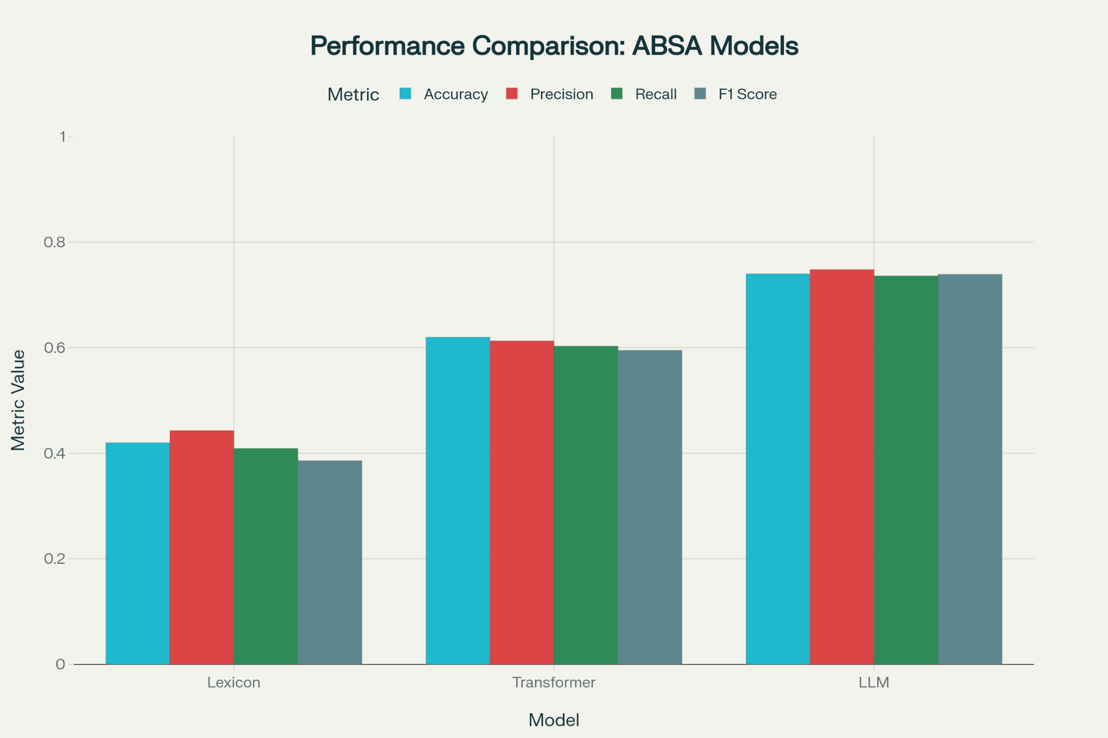

Slide 9
When to Use Each Approach
LexiconABSA
Real-time applications
Resource-constrained environments
On-device processing
TransformerABSA
Batch processing
Quality priority with available compute
Balanced accuracy/speed needs
LLMABSA
Rapid prototyping
Diverse/unseen domains
Maximum accuracy priority

Slide 10
Potential Improvements
Domain-specific lexicon expansion
Better multi-word phrase detection
Larger LLM models (13B/70B parameters)
Hybrid approaches combining extraction + classification
Multi-language support
Real-time feedback integration
Custom sentiment categories

Slide 11
Key Takeaways
ABSA benefits from combining extraction logic with robust sentiment classifiers
Shared interfaces enable fair comparison across different approaches
Trade-offs exist between accuracy, speed, and resource usage
LLMs are powerful but require careful output control
Choice of approach depends on specific use case requirements

